Slide 1

ELSA Workshop
Day Two – Session Two
ELSA is funded by the Australian Government Department of Education and Training through the National Innovation and Science Agenda

Slide 2
Preparing for the ELSA pilot
Educator app; Screen time; Device management

Slide 3
Exploring the Educator App
Notes:
Discussion for table group – to be supported by ECE team and working group educators
Record ideas for sharing

Slide 4
Managing devices
What are some ways your centres manage devices currently?
time
equal participation
observation and reporting
Notes:
Discussion for table group – to be supported by ECE team and working group educators
Record ideas for sharing

Slide 5
Screen time
How do we communicate to parents about screen time?
What are some useful answers to their questions?
Notes:
Discussion for table group – to be supported by ECE team and working group educators
Record ideas for sharing

Slide 6
Communicating with families
How can the ELSA team support you communicate to families about the ELSA pilot?
Notes:
Discussion for table group – to be supported by ECE team and working group educators
Record ideas for sharing

Slide 7
ELSA apps in practice
App Two – Location and Arrangement
Notes:
App 2 is due for rollout around April.
We are still in the early app development phase of the rollout – so we will just get to see some initial design ideas today.

Slide 8

Lucy in the City (Julie Dillemuth)
Think about the type of language used in the book that relates to position and location.
Other stories to use include
We’re going on a bear hunt
Franklin’s Neighbourhood
Notes:
As before – we will utilise the Experience | Represent | Apply model from App One.
A great way to start is with stories. As I read the story think about the type of language that is used to provide information about Position (Arrangement) and Location.

Slide 9
Map the Room
Based upon your place of birth, position yourself in the room relative to the ELSA team member who is representing the current city.
You may use whatever tools and communication methods you deem fit.
Notes:
If you are born overseas you can have a go at representing that – or you can just pick a place in Australia you lived for a while etc.
Position is relative to something
– Egocentric - From my perspective
– Allocentric - From the perspective of others
Spatial Language – Largely use prepositions
Scale – One step might equal 1 km or 10 km or 1 000 km.

Slide 10
Map the room (Discussion)
What tools can you use to better understand your place of birth relative to the workshop venue?
What communication and investigation strategies did you use when determining your place in space? What did you notice other people doing?
How did you confirm your location made sense?
How could you support someone to find a location? How could you learn further from someone who had completed the problem?
Notes:
We will use some of the technology available in the apps – camera, Augmented Reality (AR) codes etc. to help children have a deeper experience of their centre.

Slide 11
Spatial reasoning: What do we mean?
Think about the route you took to get to this room today.
How did you find your way? Did you ask directions?
Have you ever had to re-arrange furniture in a room (or re-arrange the dishwasher!)?
How did you go about it?
What sorts of skills were you using?
Notes:
Directions – might have been wayfaring instructions – e.g. turn at the big shopping centre, drive until you reach the Golden Arches – or they might have been compass based – drive north east etc.
Rearranging furniture – or the dishwasher – skills include relative size of things / aesthetics / mental activities such as rotation / mental activities such as visualisation or orientation (what will it look like from the hallway etc).
As Tom mentioned yesterday – spatial skills are the huge predictor of success later in STEM.

Slide 12
Location and Arrangement Conceptual development
Orientation
Arrangement
Location
Position
Notes:
As was the case with the patterns and relationships app
We see the children experiencing a range of opportunities starting with
Language and describing themselves and things in their world - Where am I now? Above/Below/Beside
THEN – Becoming more sophisticated in describing their location and following instructions - Where am I going? How do I get there? Up/Down; Back/Forward.
THEN – Using their knowledge of position and location to represent how things are – we will see examples of this shortly.
AND FINALLY – Understanding that the ways things are arranged can be different for others - arranged - I am here, you are over there, I can see this, what can you see from over there?.

Slide 13
Location and Arrangement: What do we mean?
Position
Location
Arrangement
Orientation
Language development with spatial prepositions (e.g., under, on top, above, inside, near, etc.)
Following and giving directions in a spatial environment that may or may not be from your own viewpoint (Egocentric – intrinsic) or Allocentric
Representing spaces and objects in space (using objects/pictures to make/show enclosures, roads etc.)
Fixed point; multi points; moving agent, me and others, following directions, giving directions (Egocentric - relative)
Notes:
GET TOM TO PROVIDE MORE INFO
In the mapping the room activity.
Ego relative = my position of myself relative to Adelaide
Ego intrinsic – other’s position from my perspective relative to Adelaide
Allocentric – imagining how this looks from the perspective of someone else.
Four photos facing out = take photo – shuffle camera – get back in the correct position.
Take some photos of a few things – stand where the photo was taken from. Top side – front view – birds eye view.

Slide 14
Developmental theory for young children
Move from Egocentric to Allocentric views
Egocentric is my view, what I see.
Allocentric is representing objects from the viewpoint of someone/something other than yourself
Two main visual frames of reference for Egocentric:
Relative = me relative to others (people and objects) in space (Mapping the room activity)
Intrinsic = objects and people (who are not me) relative to other objects and people
Notes:
Children of this age are largely egocentric – and all of the activities in the App commence from this starting point.
Some of the activities can include the beginnings of allocentric thinking.
GET TOM TO PROVIDE THREE CLEAR EXAMPLES – EGO (Relative) | EGO (Intrinsic) |
Allocentric – Use one iPad per table and take a photo from somewhere in the room – make sure I record where they were taken from – educators have to locate where in the room the photo was taken from.
Backup plan - Four photos facing out = take photo – shuffle camera – get back in the correct position.

Slide 15
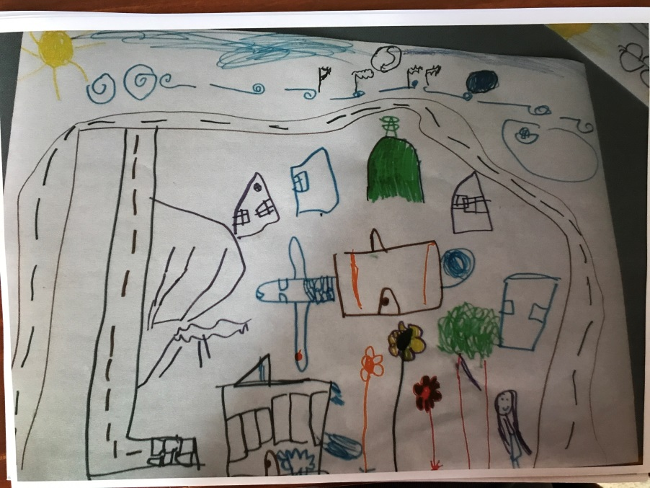
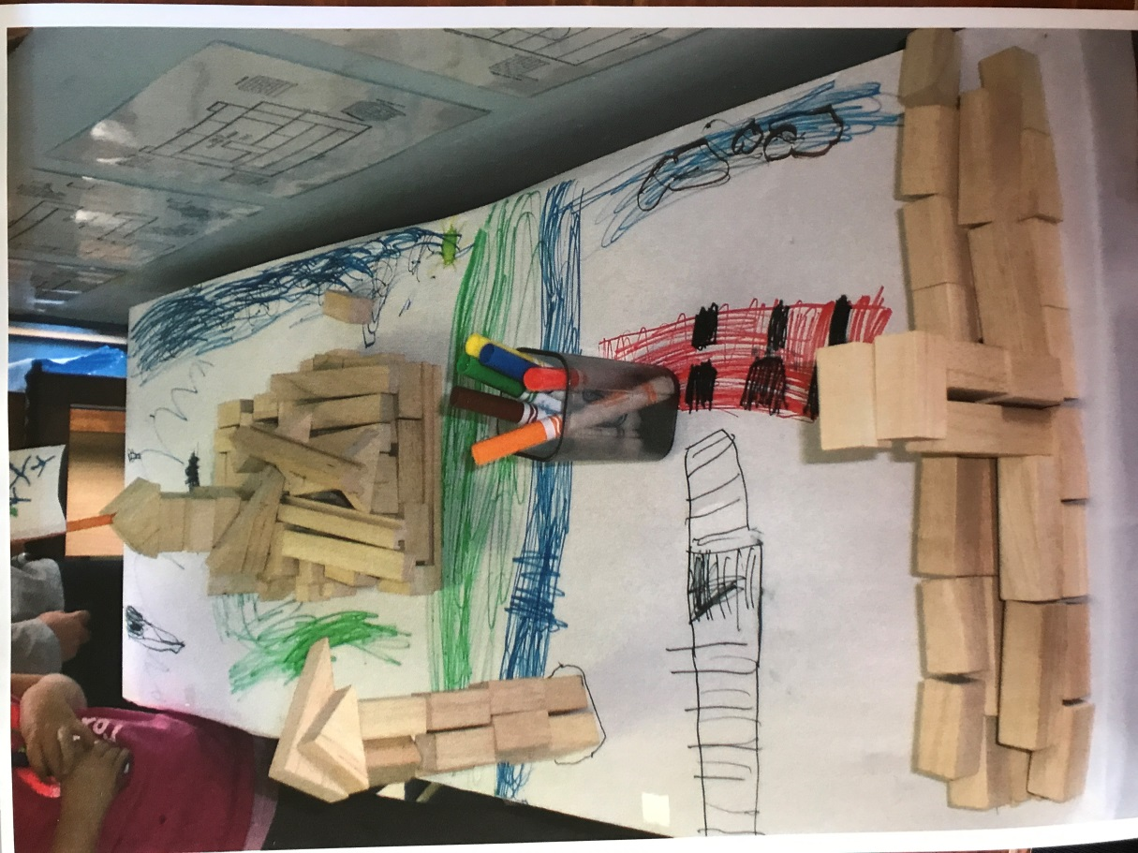
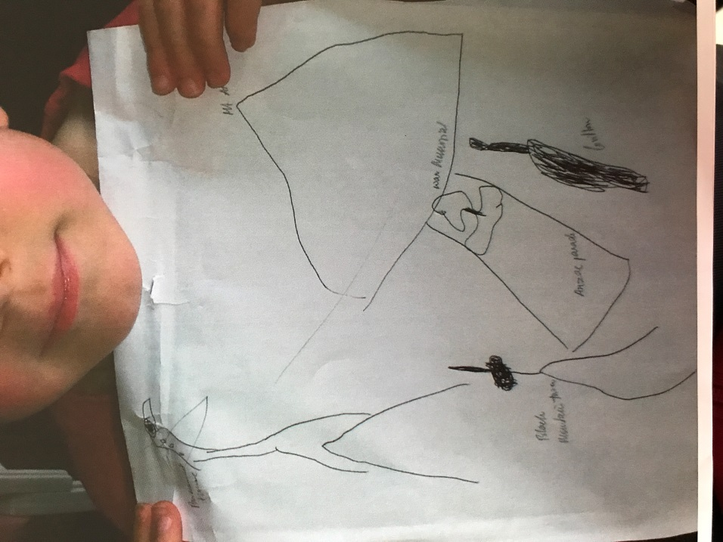
Examples of children’s ideas
Notes:
At Right - Drawing and blocks – war memorial and parliament house – carillion / eagle – Photos as a reference – Egocentric as they were building what they had seen.
Middle – Black Mt – telstra – Anzac Parade in middle with war Memorial in middle – carillion on right
At Left – Mapping
Photo of Mt Ainslie on last slide

Slide 16
Children’s App 2
There are four activities in the app to engage with, based on the four areas of conceptual development
Excursions (Position)
Amy’s Adventure (Location)
Mapping (Arrangement)
Directions (Orientation)
Notes:
SPEAK TO TOM - about what we want to about sequence.
We are still in the early build stage so we will just use some images from the design brief to give you a sense of the app. We will be user testing this late this year and early next year.

Slide 17
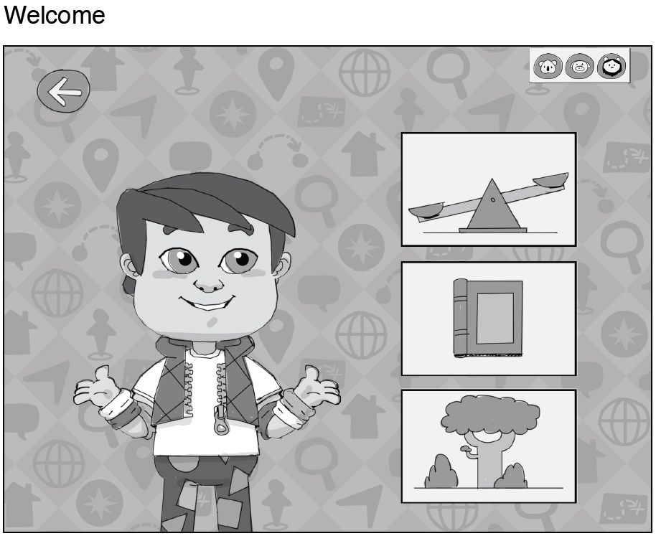
Excursions (Position)
Focus on positional language involving both static/stationary and motion/active language
There are three excursions to choose from:
At the park
At the library
Exploring the bush
Notes:
Static / stationary – On / under / next to etc
Active / motion = Across, through, into etc
Active – Across / through / into
Passive – On / below etc.

Slide 18
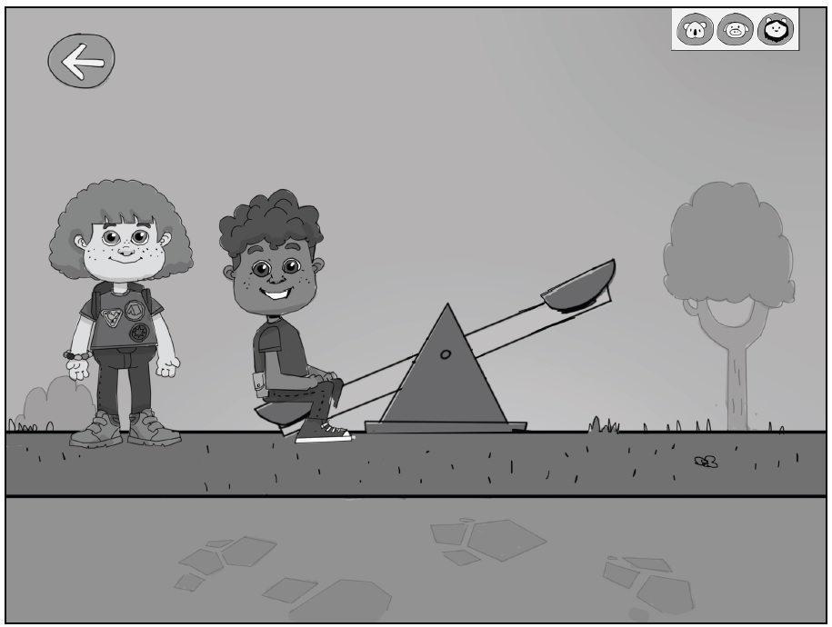
At the park
KEY SPATIAL TASKS
Place Amy opposite Elliot on the see-saw
Look under the blanket to make sure you have not squashed Amy’s banana
Push (kick) the soccer ball between the goal posts to score a goal
Notes:
Place Amy opposite Elliot on the see-saw (reaction: see saw balances)
Look under the blanket to make sure you have not squashed Amy’s banana (flat banana on the ground)
Push (kick) the soccer ball between the goal posts to score a goal (cheers)

Slide 19
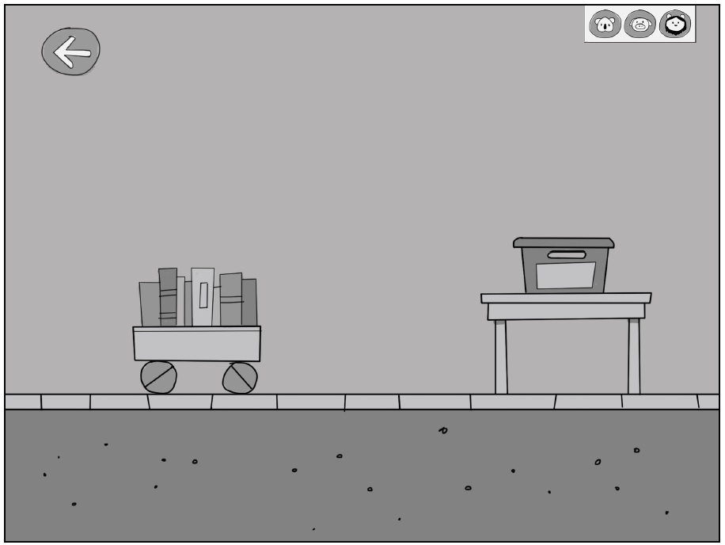
At the library
KEY SPATIAL TASKS
Focusing on positional language
in/on/near/far/up/down/under/over / across / through
Both active and passive positional language
Notes:
Push the trolley of books across the library to the desk and stack them in the blue tub (too many books means that they end up stacking up out the top of the tub like a tower)
Post the books through the return shute in the wall (reaction heavy echo SFX when it hits the bottom)

Slide 20
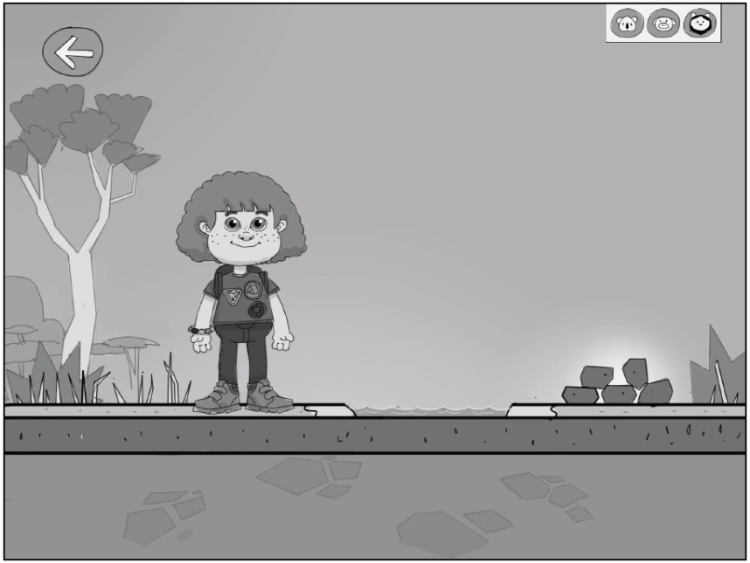
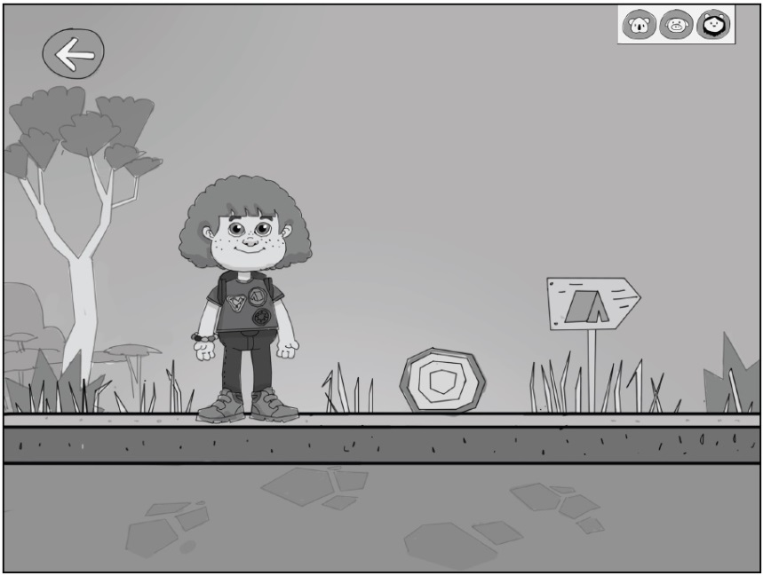
Exploring the bush
KEY SPATIAL TASKS
Placing objects in certain positions based on directions
Encouraging decision making based on positional language
Notes:
Place stepping stones across the creek so that Amy can cross over without getting her shoes and socks wet
Move the branch off the path so that Amy can pass and walk down to the creek
Put the mudcrab net in the water alongside the log at the edge of the river to catch a crab

Slide 21
Activity using AR codes
Working in small groups, you will gather all the clues using the AR reader on the tablets.
The AR codes are placed around the room.
You can collect the clues in any order. There are 6 AR codes altogether.
Follow the instructions on the AR code. Make notes in your workbook.
Notes:
Rob to run this activity.

Slide 22
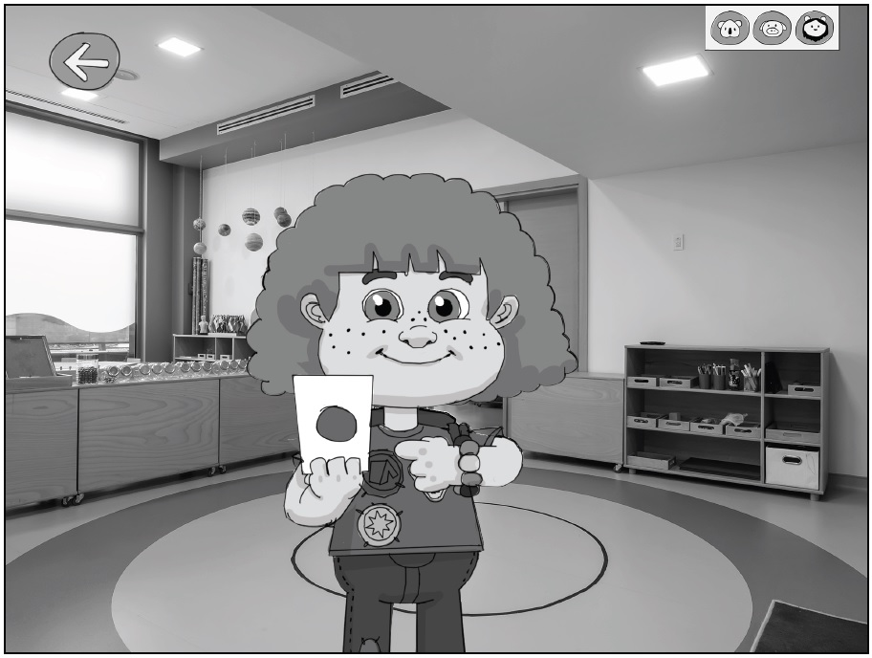
Amy’s Adventure (Location)
Children will be able to play a real world augmented reality (AR) adventure game helping them to understand language that describes locations.
Amy will direct the adventure using spatial audio descriptions to describe locations in the preschool
Notes:
Educators will be able to encode information in the beacons – if you wish – that is particular to your centre and record your own directions (Check with CKL)
We will pre-program locations that we anticipate are in most if not all centre – Block Area, Outdoor Play Area, Book Corner etc.

Slide 23
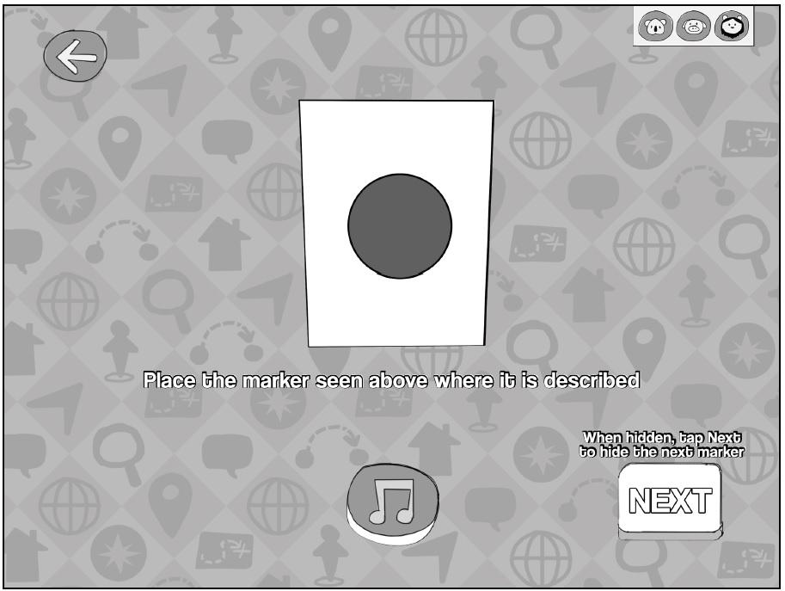
Amy’s Adventure
Using digital tools to interpret location different perspectives
Screen space and real space using AR markers
Notes:
The activity uses AR markers and allows children to see and listen to Amy in Augmented Reality.
The AR markers can be stuck to surfaces in the preschool by tape, blue tack or velcro.
The camera on the device allows children to collect and capture the hidden markers they find.

Slide 24
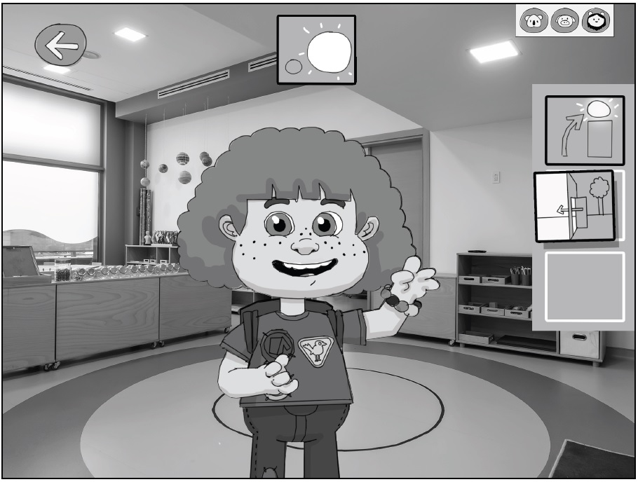
Amy’s Adventure
Each adventure is composed in a randomised order and an increasing number of locations, this makes each adventure exciting and varied.
Notes:
Capture all the location markers to earn a Best Listener or Best Explorer badge from Amy.
As I mentioned Amy’s instructions, and the locations, can also be set up by the educator selecting options appropriate for each preschool (CONFIRM)
Each adventure is composed in a randomised order and an increasing number of locations, this makes each adventure exciting and varied.
Can teachers code the beacons pretty easily?

Slide 25
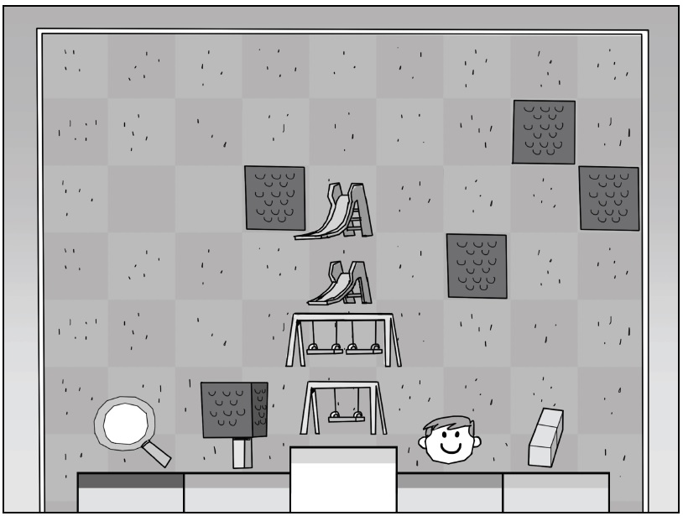
Mapping (Arrangement)
Development of arrangement skills
Children represent their preschool playground map by placing and then arranging the position of objects in space.
Notes:
Children represent their preschool playground map by placing and then arranging the position of objects in space.
Children only need to get objects within their map in a relatively correct position.
Different sized things – small swing, big swing etc.

Slide 26
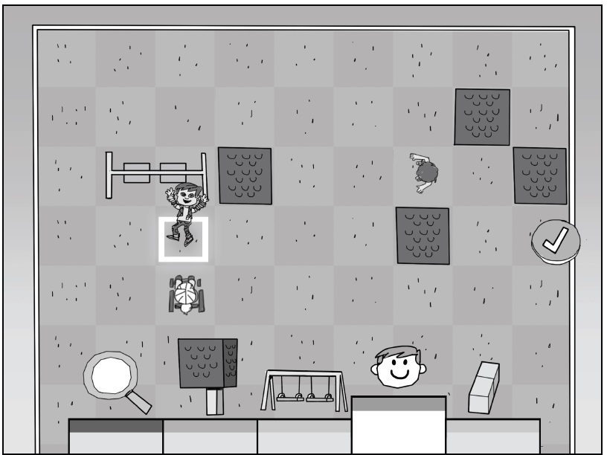
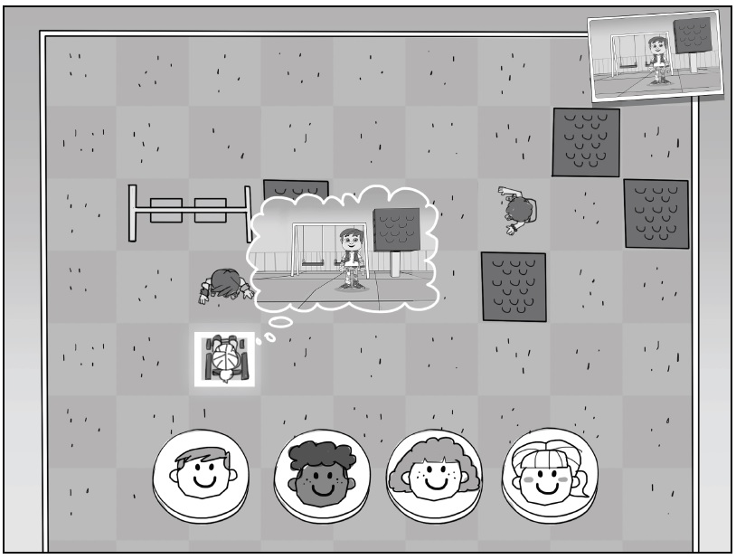
Mapping
Once the map is constructed children can see the map from different perspectives and points of views.
Orientation skills are reinforced
Notes:
Once the map is constructed children can see the map from different perspectives and points of views.
Characters on the map use spatial terms to describe what they see, who is front of them, and what they are near.
Finally, children will see another character’s point of view to determine who’s view they are seeing.
Allocentric – dragging one of the ELSA characters to a position to see what they see
Ask Shane how this will work.

Slide 27
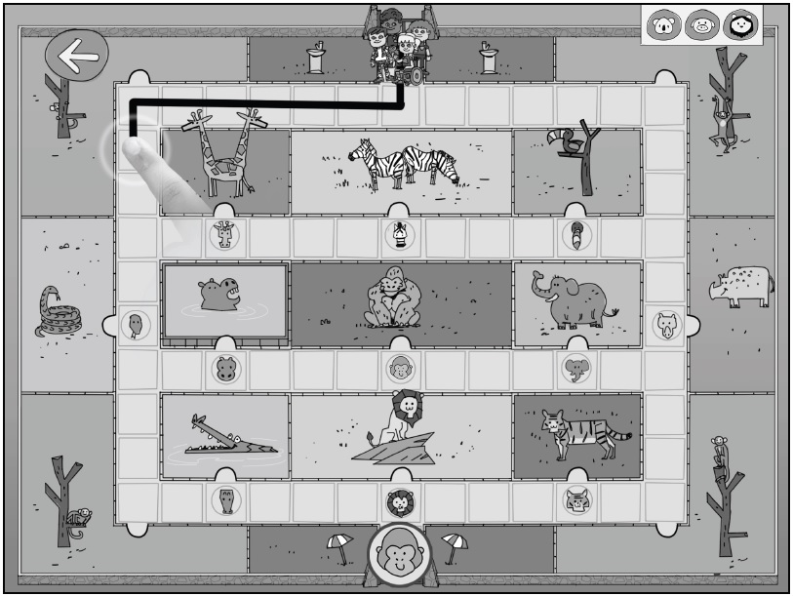
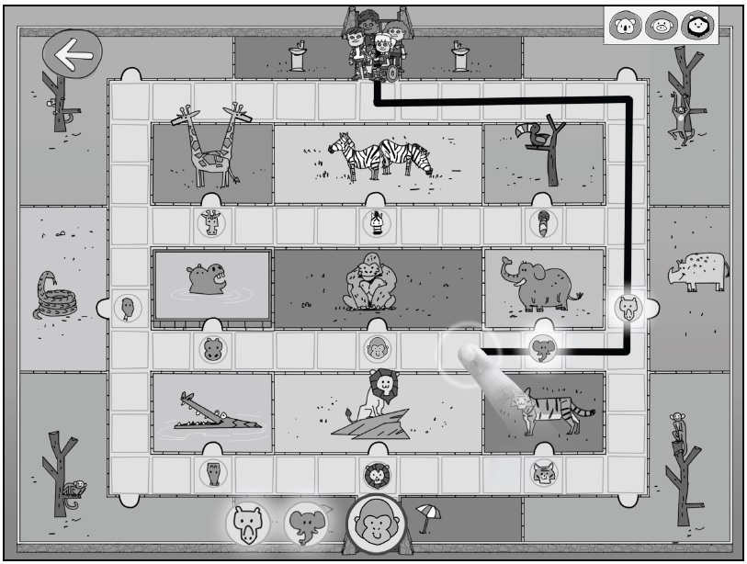
Explore the Zoo (Orientation) - We will play if we have time
Orientation skills are developed
Children navigate within a space
Notes:
Make your way around the zoo - draw a line from point A to B by following the directions
Movement begins from one of the ELSA characters, with spatial language to describe the sequence of directions.
Extensions to this include through a waypoint (A-B-C).
Then a final sub-level with up to 4 options to choose from (A-B-C-D).
Two zoos – a traditional one and an open plains one.

Slide 28
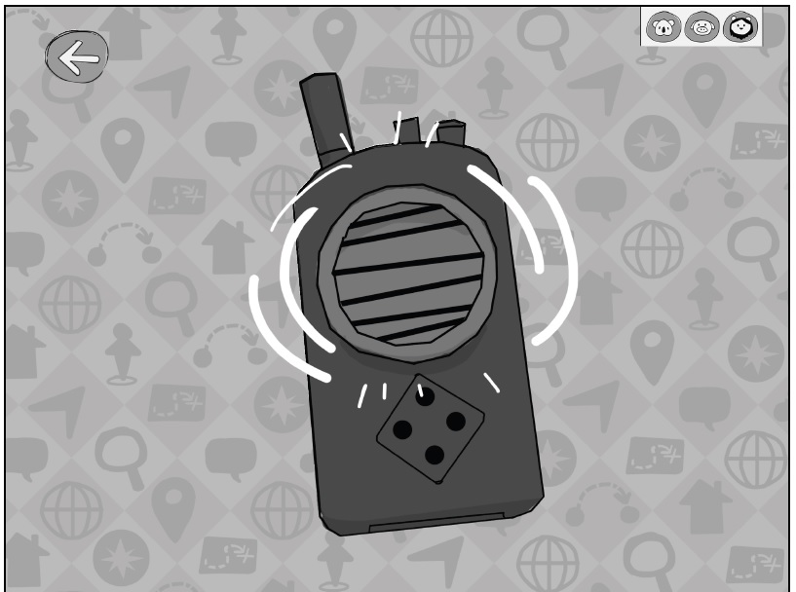
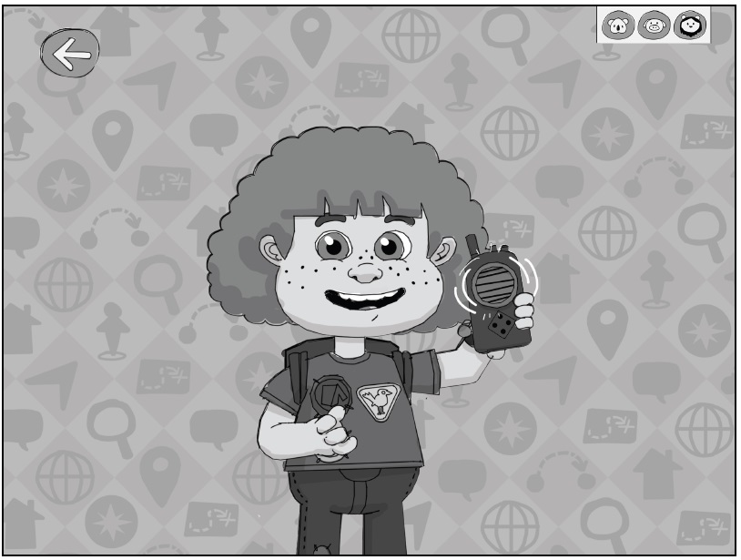
Piper is Lost
Focus on more difficult position and location skills when interpreting directions
Notes:
Piper (or one of the other characters) is lost in the zoo.
Piper will provide audio directions by a walkie talkie describing a sequence of instructions using spatial language with landmarks.
Pick where on the map Piper is so the other characters can find her.

Slide 29
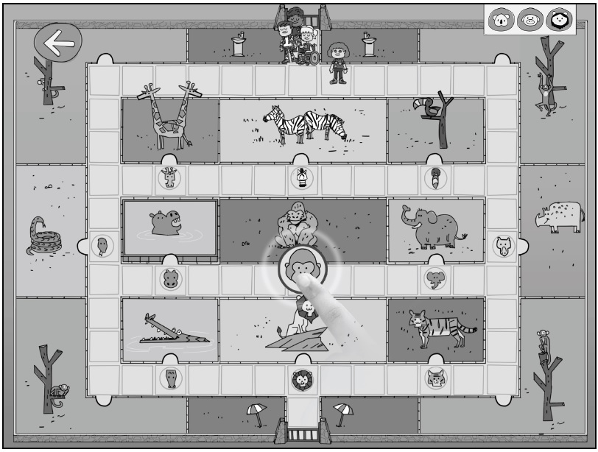
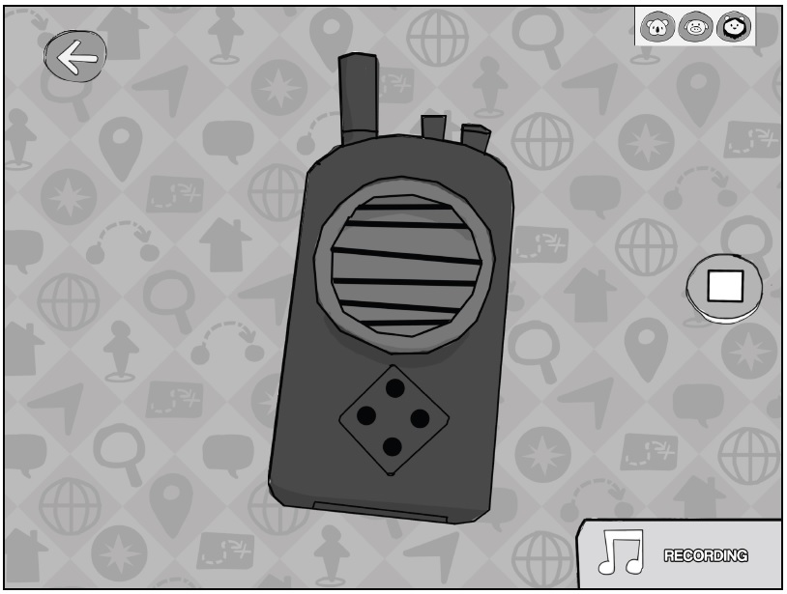
Hide and Seek
Children develop wayfinding skills as the navigate find lost characters.
Uses spatial language to locate objects as the child’s orientation changes
Notes:
The ELSA characters are playing hide and seek at the zoo
Either the game or one child hides a character on the map, the second child has to follow directions to find the character.
As in Piper Is Lost, audio instructions will use spatial language with landmarks to describe where the character is.
Turn-based interaction plays out between the children, with an incentive so that the child who can find the character the fastest/ fewest number of attempts wins.

Slide 30
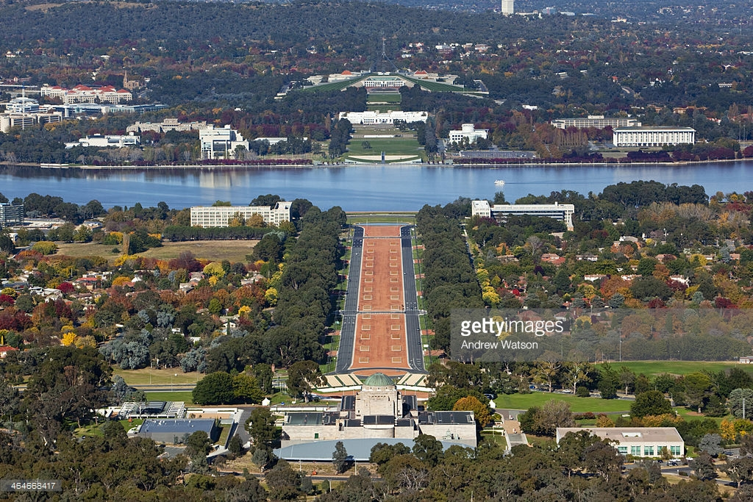
View from Mt Ainslie

